Slide 1
History of Stringed Instruments
By: Laney Whittle

Slide 2
So what is a stringed Instrument?
A string instrument is defined as,
“an instrument that has strings in its body, which when rubbed by a bow, plucked, or struck, produce different sounds depending on the intensity of vibration produced”

Slide 3
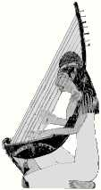
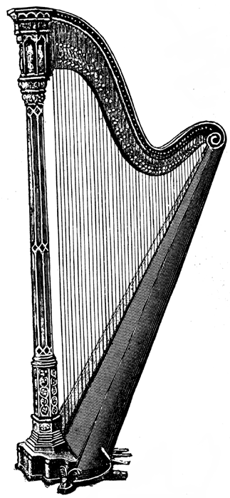
The Harp
The angled harp was one of the earliest forms of a Harp. Dates back to 3000BC. The design was noticed by paintings and illustrations on Egyptian tomb walls. Broad, wooden sound box was connected with a curved branch of certain dimensions. Strings varied between 3 and 10
Appeared in Europe during the first millennium. The triangulated frame strengthened the frame and make string tensions become stronger. These harps were handed down from generation to generation.

Slide 4
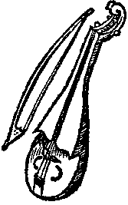
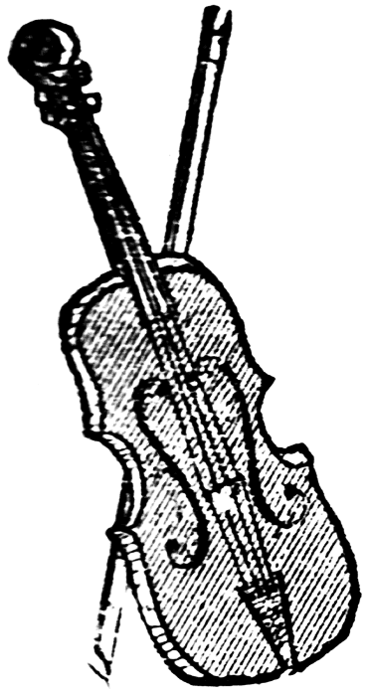
Bowed Instruments
The Rebec one of the earliest bowed instruments ever recorded. During medieval times the rebec was a popular instrument used. The rebec was always played vertically because it was positioned on or between the knees. Also referred to as a ribible
The Fiddle was a popular instrument in the medieval time period that consisted of three to five strings all tuned in fifths. It was slightly larger than the Viola, the Fiddle was round or heart-shaped and had wooden tuning pegs that were mounted below or above the strings.
Notes:
Both of these created the modern day violin

Slide 5
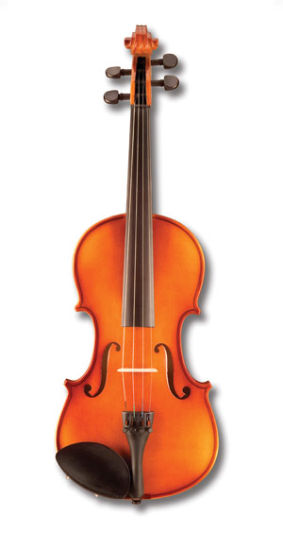
Violin
Originated from the Rebec and Fiddle
Medieval
Modern
Notes:
Originated from the Riddic and Fiddle…the Violin took the shape and structure and conformed to this.

Slide 6
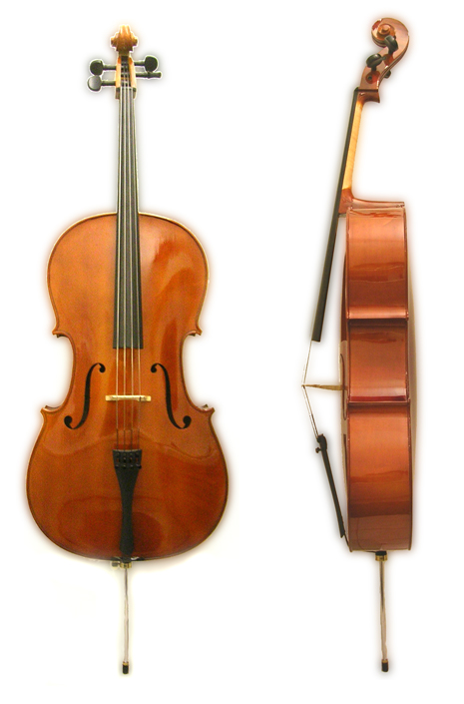
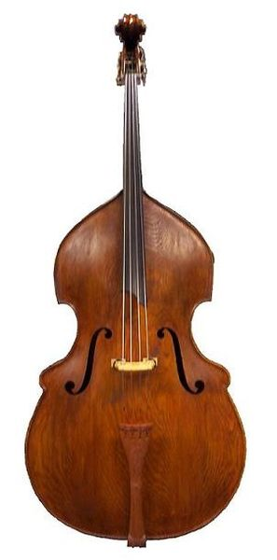
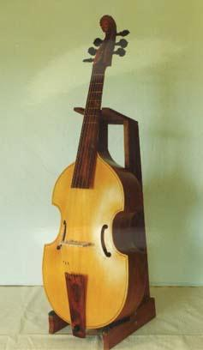
Viol to the Cello
A viol is a bowed string instrument. Like the cello, the viol, or viola da gamba, is played between the legs (hence the name 'viola da gamba', literally 'leg-viol'). While it is not a direct ancestor of the violin, there is some kinship between the two instrument families.

Slide 7
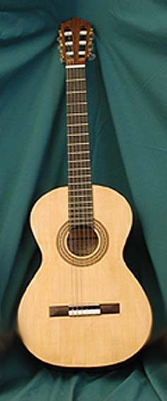
Guitar
The Gittern was the most similar instrument that pre-dated the modern day guitar. The flat body and neck were made from a single piece of Timber and normally had four single courses of strings. The Gittern was replaced by the guitar in the mid-seventeenth century.
Gittern
Guitar

Slide 8
Resources
http://www.funkysonglyrics.com/Music-History/History-Of-The-String-Instruments.html
http://www.google.com/search?q=history+of+stringed+instruments&sourceid=ie7&rls=com.microsoft:en-us:IE-SearchBox&ie=&oe=&rlz=1I7GGLR_en#q=history+of+stringed+instruments&hl=en&rls=com.microsoft:en-us:IE-SearchBox&rlz=1I7GGLR_en&prmd=iv&tbs=tl:1&tbo=u&ei=aAzUTIq0LMH_lgeOvdSYBQ&sa=X&oi=timeline_result&ct=title&resnum=11&ved=0CEMQ5wIwCg&fp=10b14eaafe3b4c99
http://www.oracle.com/splash/thinkquest/down.html
http://www.classicol.com/classical.cfm?music=instrumentInfo&section=StringHistory&title=String+Family+History

